Slide 1
CS7/8745 : Machine Learning Instructor: Salim Sazzed Department of Computer Science University of Memphis

Slide 2
Supervised Machine Learning Algorithm

Slide 3
Important Concepts
Supervised Learning Dataset:
Dataset:
Sample1 = list of feature(s) + (class label, or some value)
Sample2 = list of feature(s) + (class label, or some value)
Sample3 = list of feature(s) + (class label, or some value)
Unsupervised Learning:
Dataset:
Sample1 = list of feature(s)
Sample2 = list of feature(s)
Sample3 = list of feature(s)
For Classification
For regression

Slide 4
BRIGHTNESS | SATURATION | CLASS
40 | 20 | Red
50 | 50 | Blue
60 | 90 | Blue
10 | 25 | Red
70 | 70 | Blue
60 | 10 | Red
25 | 80 | Blue
Supervised or Unsupervised?
Classification or Regression

Slide 5
Training Data:
Data used to train the machine learning model / used to learn relationship between features and class label of samples for predictions
Testing Data:
Unseen or new data, not used during the training process, used to determine effectiveness/performance of a trained model

Slide 6
Instance-based learning Vs model-based learning
Training Dataset
Instance-based learning, also known as "lazy learning," relies on storing the training instances (data points)
Makes predictions by comparing new instances to the stored examples.
BRIGHTNESS | SATURATION | CLASS
40 | 20 | Red
50 | 50 | Blue
60 | 90 | Blue
10 | 25 | Red
70 | 70 | Blue
60 | 10 | Red
25 | 80 | Blue
A new data (testing data)
BRIGHTNES = 20.
SATURATION = 35

Slide 7
Instance-based learning
It doesn't explicitly create a generalized model or make extensive computations during training.
Common instance-based learning algorithms include k-nearest neighbors (KNN).

Slide 8
Training Dataset
In contrast, model-based learning algorithms build a mathematical or statistical model from the training data
Captures the underlying patterns and relationships between the input features and the target variable.
These models are then used to make predictions on new, unseen data.
BRIGHTNESS | SATURATION | CLASS
40 | 20 | Red
50 | 50 | Blue
60 | 90 | Blue
10 | 25 | Red
70 | 70 | Blue
60 | 10 | Red
25 | 80 | Blue
80 | 80 | Orange
Rule1: If Brightness >= 80 and Saturation >= 80
Class = Orange

Slide 9
Examples of model-based algorithms include linear regression, decision trees, support vector machines, and neural networks.
These algorithms aim to create a more abstract and general representation of the data, rather than relying on the specific training instances.

Slide 10
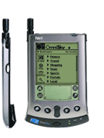
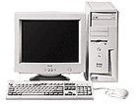

Instance-based Learning
Its very similar to a
laptop!!
Slides courtesy: Dipanjan Chakraborty

Slide 11
K-Nearest Neighbor Learning
K-nearest neighbors (KNN) is a type of instance-based supervised learning algorithm used for both regression and classification.
Nearest means closest/most similar
KNN tries to predict the class of a new data by calculating the distance between itself and all the training points.
An idea that can be used for machine learning— as does another maxim involving poultry: "birds of a feather flock together."
In other words, things that are alike are likely to have properties that are alike.
We can use this principle to classify data by placing it in the category with the most similar, or "nearest" neighbors.
https://www.youtube.com/watch?v=4HKqjENq9OU

Slide 12
1-Nearest Neighbor
Black = class type 1
Blue = class type 2
Y
X

Slide 13
3-Nearest Neighbor
Y
X

Slide 14
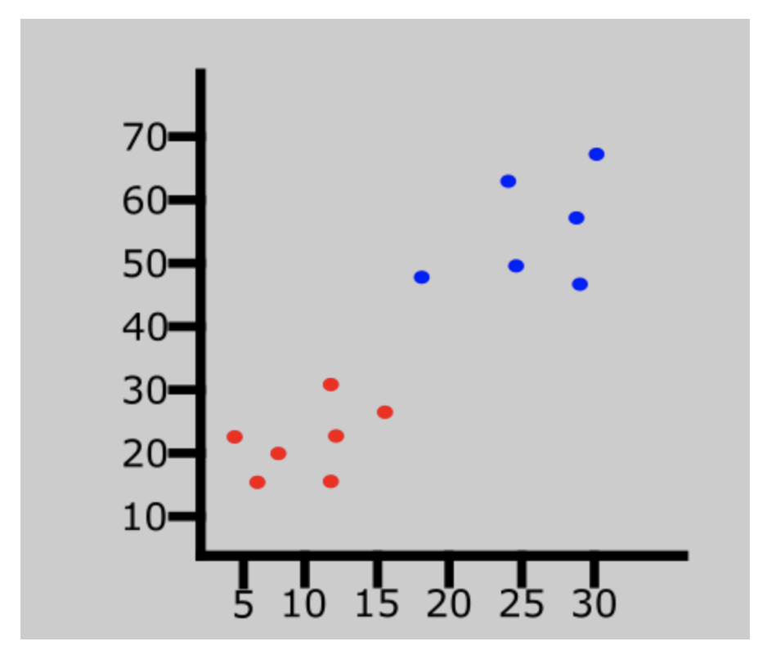
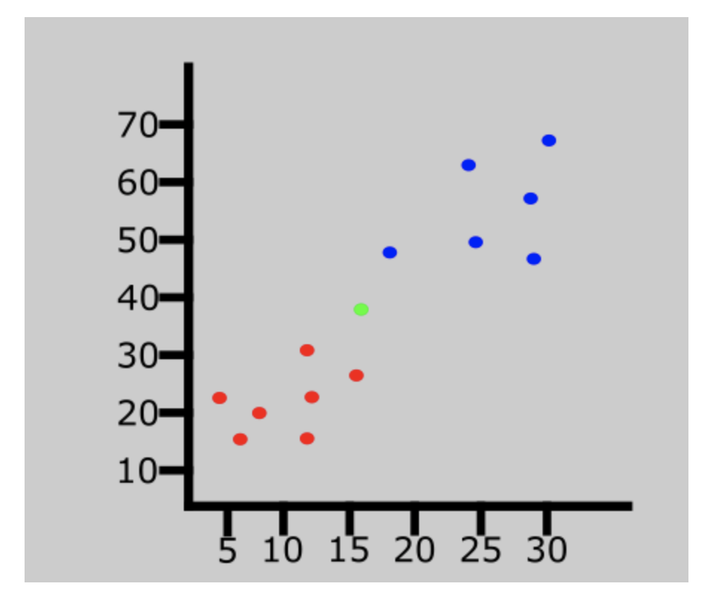
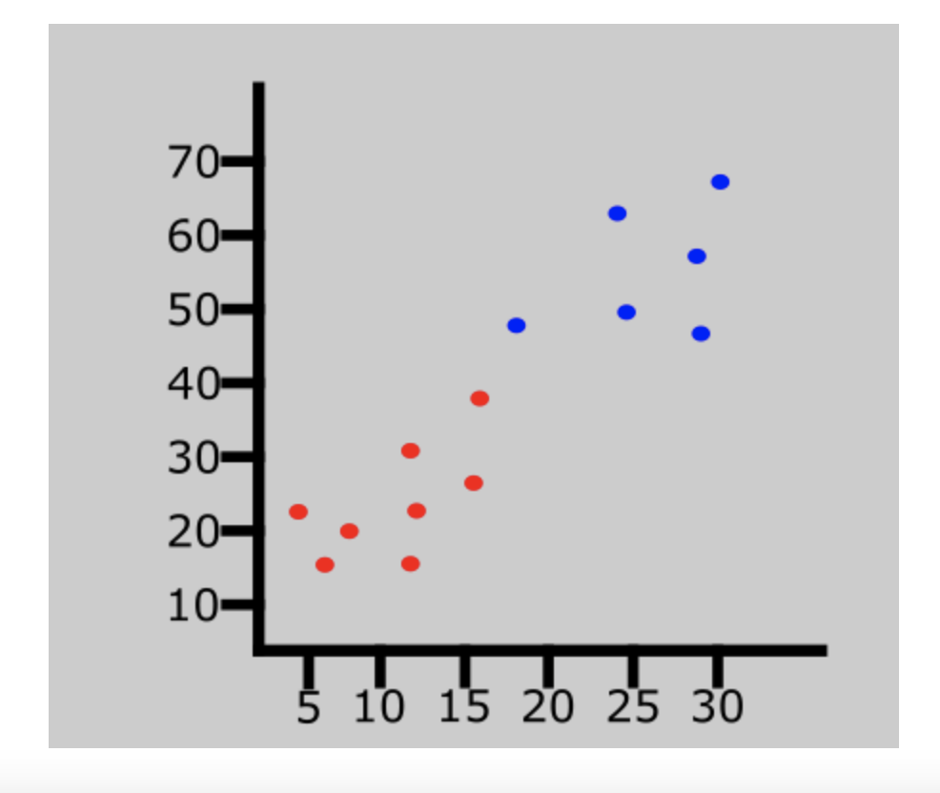
https://www.freecodecamp.org/news/k-nearest-neighbors-algorithm-classifiers-and-model-example/

Slide 15
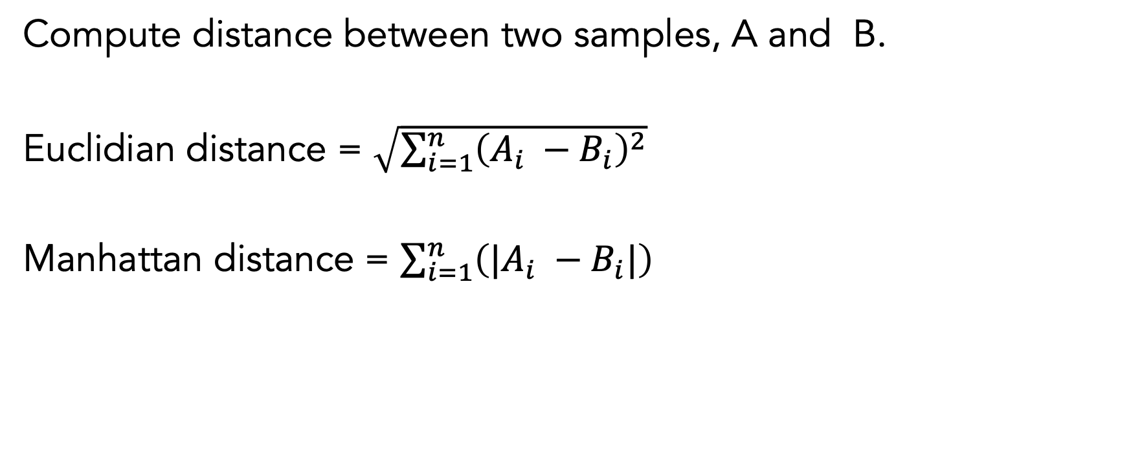
Distance/Similarity Measures
Compute distance between two samples, A and B.
Euclidian distance = $\sqrt{\sum_{i=1}^{n}{{\left(A_{i} −B_{i}\right)}^{2}}}$
Manhattan distance = $\sum_{i=1}^{n}{{\left(|A_{i} −B_{i}|\right)}^{ }}$

Slide 16
Training Data
BRIGHTNESS | SATURATION | CLASS
40 | 20 | Red
50 | 50 | Blue
60 | 90 | Blue
10 | 25 | Red
70 | 70 | Blue
60 | 10 | Red
25 | 80 | Blue
Testing/Unseen/New data
BRIGHTNESS | SATURATION | CLASS
20 | 35 | ?

Slide 17
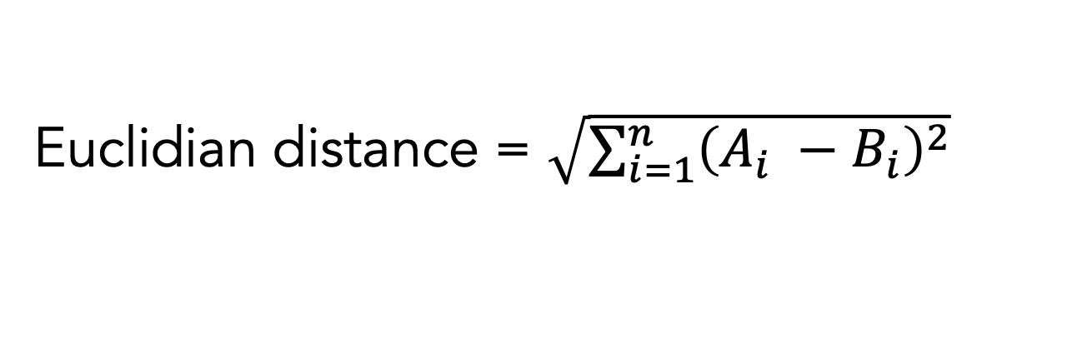
Euclidian distance = $\sqrt{\sum_{i=1}^{n}{{\left(A_{i} −B_{i}\right)}^{2}}}$
BRIGHTNESS | SATURATION | CLASS | DISTANCE
40 | 20 | Red | ?
50 | 50 | Blue | ?
60 | 90 | Blue | ?
10 | 25 | Red | ?
70 | 70 | Blue | ?
60 | 10 | Red | ?
25 | 80 | Blue | ?
A = new data
BRIGHTNES (20) SATURATION (35)
B = one of the samples from training data

Slide 18
Sort distance to all training samples
BRIGHTNESS | SATURATION | CLASS | DISTANCE
40 | 20 | Red | 25
50 | 50 | Blue | 33.54
60 | 90 | Blue | 68.01
10 | 25 | Red | 10
70 | 70 | Blue | 61.03
60 | 10 | Red | 47.17
25 | 80 | Blue | 45

Slide 19
BRIGHTNESS | SATURATION | CLASS | DISTANCE
10 | 25 | Red | 10
40 | 20 | Red | 25
50 | 50 | Blue | 33.54
25 | 80 | Blue | 45
60 | 10 | Red | 47.17
70 | 70 | Blue | 61.03
60 | 90 | Blue | 68.01
K= 3
K= 5

Slide 20

Solve:
Use Manhattan Distance to find the nearest neighbor
$\sum_{i=1}^{n}{{\left(|A_{i} −B_{i}|\right)}^{ }}$
BRIGHTNESS | SATURATION | CLASS | DISTANCE
40 | 20 | Red | ?
50 | 50 | Blue | ?
60 | 90 | Blue | ?
10 | 25 | Red | ?
70 | 70 | Blue | ?
60 | 10 | Red | ?
25 | 80 | Blue | ?
Testing data
BRIGHTNESS | SATURATION | CLASS
20 | 35 | ?

Slide 21
Advantages
Simplicity: K-NN is easy to understand and implement.
No Training Period: K-NN is an instance-based learning algorithm, meaning it doesn't require a training period. It stores the entire dataset in memory and makes predictions based on the similarity of new data points to existing ones.
Robust to Outliers: K-NN can handle noisy data and outliers reasonably well because it relies on local information from its neighbors. Outliers may have less impact if they are distant from most data points.
No Assumption of Linearity: Unlike linear models, K-NN can capture non-linear relationships in the data without explicitly modeling them. This makes it suitable for tasks where the decision boundaries are not linear.

Slide 22
Limitations (1)
Computational Complexity: K-NN can be computationally expensive, especially for large datasets. Calculating distances between a query point and all data points in the dataset can be time-consuming, and as the dataset size grows, the algorithm's runtime increases proportionally.
Sensitivity to the Choice of k: The choice of the number of neighbors (k) is critical, and selecting an inappropriate value can lead to poor model performance. A small k may result in overfitting, while a large k may lead to underfitting. Determining the optimal k can require experimentation and domain knowledge. Distance Metric Sensitivity: K-NN's performance is highly dependent on the choice of distance metric. Different distance metrics (e.g., Euclidean, Manhattan, cosine similarity) can yield different results for the same dataset. Selecting the right distance metric is often a challenge and requires domain knowledge.

Slide 23
Limitations (2)
Curse of Dimensionality: K-NN becomes less effective as the number of features (dimensions) in the dataset increases. In high-dimensional spaces, data points tend to become equidistant from each other, making it harder to distinguish between them. This can lead to a degradation in model performance and increased computational requirements.
Storage Requirements: K-NN stores the entire dataset in memory during the prediction phase, which can be memory-intensive for large datasets.
Slow Prediction: Since K-NN performs computations during prediction for each query point, it can be slow when making predictions for multiple data points or in real-time applications.

Slide 24
# Import necessary modules
from sklearn.neighbors import KNeighborsClassifier
from sklearn.model_selection import train_test_split
from sklearn.datasets import load_iris
# Loading data
irisData = load_iris()
# Create feature and target arrays
X = irisData.data
y = irisData.target
for i in range (len(X)):
print(X[i], y[i])
# Split into training and test set
X_train, X_test, y_train, y_test = train_test_split(
X, y, test_size = 0.2, random_state=42)
knn = KNeighborsClassifier(n_neighbors=5)
knn.fit(X_train, y_train)
# Predict on dataset which model has not seen before
print(knn.predict(X_test))
https://scikit-learn.org/stable/
https://www.geeksforgeeks.org/k-nearest-neighbor-algorithm-in-python/

